Slide 1
Full Stack Web Development
JavaScript / Getting Started

Slide 2
Global and Local Variables
A JavaScript local variable is declared inside block or function. It is accessible within the function or block only. For example:
<script>
function abc(){
var x=10;//local variable
}
</script>
A JavaScript global variable is accessible from any function. A variable i.e. declared outside the function or declared with window object is known as global variable. For example:
<script>
var data=200;//gloabal variable
function a(){
document.writeln(data);
}
function b(){
document.writeln(data);
}
a();//calling JavaScript function
b();
</script>

Slide 3
String Object
There are 2 ways to create string in JavaScript
By string literal for example : var stringname="string value";
By string object (using new keyword)
var stringname=new String("string literal");
String Methods
CharAt(index) // str.charAt(2)
concat(str) // var s1="javascript "; var s2="concat example"; var s3=s1.concat(s2);
indexOf(str) // var s1="javascript from javatpoint indexof"; var n=s1.indexOf("from");
lastIndexOf(str) // var s1="javascript from javatpoint indexof"; var n=s1.lastIndexOf("java");
toLowerCase() // var s1="JavaScript toLowerCase Example"; var s2=s1.toLowerCase();
toUpperCase() // var s1="JavaScript toUpperCase Example"; var s2=s1.toUpperCase();
slice(beginIndex, endIndex) // var s1="abcdefgh"; var s2=s1.slice(2,5);
trim() // var s1=" javascript trim "; var s2=s1.trim();

Slide 4
Date Object
The JavaScript date object can be used to get year, month and day. You can display a timer on the webpage by the help of JavaScript date object.
var today=new Date();
getDate() Get the day as a number (1-31)
getDay() Get the weekday as a number (0-6)
getFullYear() Get the four digit year (yyyy)
getHours() Get the hour (0-23)
getMilliseconds() Get the milliseconds (0-999)
getMinutes() Get the minutes (0-59)
getMonth() Get the month (0-11)
getSeconds() Get the seconds (0-59)
getTime() Get the time (milliseconds since January 1, 1970)

Slide 5
Math Object
The JavaScript math object provides several constants and methods to perform mathematical operation.
Math.sqrt(n) // returns the square root of the given number.
Math.random() // returns the random number between 0 to 1
Math.pow(m,n) // returns the m to the power of n that is m^{n}
Math.floor(n) // returns the lowest integer for the given number. For example 3 for 3.7, 5 for 5.9 etc
Math.ceil(n) // returns the largest integer for the given number. For example 4 for 3.7, 6 for 5.9 etc.
Math.round(n) // returns the rounded integer nearest for the given number. If fractional part is equal or greater than 0.5, it goes to upper value 1 otherwise lower value 0. For example 4 for 3.7, 3 for 3.3, 6 for 5.9 etc.
Math.abs(n) // returns the absolute value for the given number. For example 4 for -4, 6.6 for -6.6 etc.

Slide 6
Number & Boolean Object
The JavaScript number object enables you to represent a numeric value. It may be integer or floating-point.
var n=new Number(value);
var n=new Number(16);//integer value by number object
JavaScript Boolean is an object that represents value in two states: true or false. You can create the JavaScript Boolean object by Boolean() constructor as given below.
Boolean b=new Boolean(value);

Slide 7
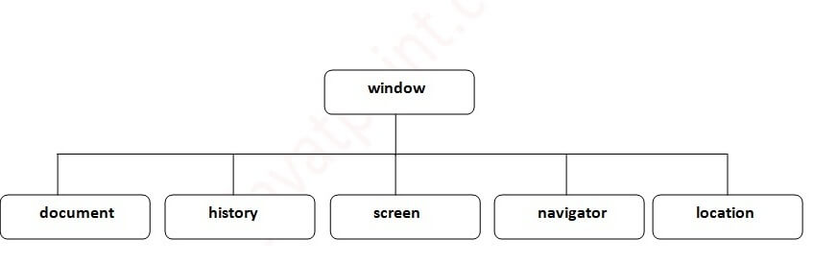
Browser Object Model (BOM)
The Browser Object Model (BOM) is used to interact with the browser
Method | Description
alert() | displays the alert box containing message with ok button.
confirm() | displays the confirm dialog box containing message with ok and cancel button.
prompt() | displays a dialog box to get input from the user.
open() | opens the new window.
close() | closes the current window.
setTimeout() | performs action after specified time like calling function, evaluating expressions etc.

Slide 8
BOM Examples
confirm() // var v= confirm("Are u sure?");
prompt() // prompt("Who are you?");
open() // open("http://www.google.com");
setTimeout()
setTimeout(
function(){
alert("Welcome to me after 2 seconds")
},2000);

Slide 9
History Object
The JavaScript history object represents an array of URLs visited by the user. By using this object, you can load previous, forward or any particular page.
The history object is the window property, so it can be accessed by:
window.history
history.back();//for previous page
history.forward();//for next page
history.go(2);//for next 2nd page
history.go(-2);//for previous 2nd page

Slide 10
Navigator Object
The JavaScript navigator object is used for browser detection. It can be used to get browser information such as appName, appCodeName, userAgent etc.
The navigator object is the window property, so it can be accessed by:
window.navigator
document.writeln("<br/>navigator.appCodeName: "+navigator.appCodeName);
document.writeln("<br/>navigator.appName: "+navigator.appName);
document.writeln("<br/>navigator.appVersion: "+navigator.appVersion);
document.writeln("<br/>navigator.cookieEnabled: "+navigator.cookieEnabled);
document.writeln("<br/>navigator.language: "+navigator.language);
document.writeln("<br/>navigator.userAgent: "+navigator.userAgent);
document.writeln("<br/>navigator.platform: "+navigator.platform);
document.writeln("<br/>navigator.onLine: "+navigator.onLine);

Slide 11
Screen Object
The JavaScript screen object holds information of browser screen. It can be used to display screen width, height, colorDepth, pixelDepth etc.
The navigator object is the window property, so it can be accessed by:
window.screen
document.writeln("<br/>screen.width: "+screen.width);
document.writeln("<br/>screen.height: "+screen.height);
document.writeln("<br/>screen.availWidth: "+screen.availWidth);
document.writeln("<br/>screen.availHeight: "+screen.availHeight);
document.writeln("<br/>screen.colorDepth: "+screen.colorDepth);
document.writeln("<br/>screen.pixelDepth: "+screen.pixelDepth);

Slide 12
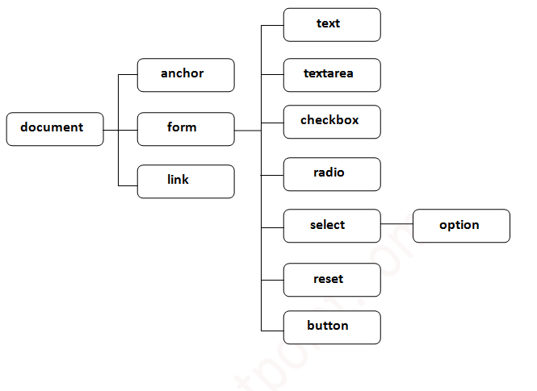
Document Object
The document object represents the whole html document.
When html document is loaded in the browser, it becomes a document object. It is the root element that represents the html document. It has properties and methods. By the help of document object, we can add dynamic content to our web page.
window.document

Slide 13
Document Object Methods
Method | Description
write("string") | writes the given string on the doucment.
writeln("string") | writes the given string on the doucment with newline character at the end.
getElementById() | returns the element having the given id value.
getElementsByName() | returns all the elements having the given name value.
getElementsByTagName() | returns all the elements having the given tag name.
getElementsByClassName() | returns all the elements having the given class name.

Slide 14
Prototyping

